Slide 1
“AGROFRIEND” AGROPRODUCTS PRICE PREDICTOR
6th Semester Project – 21CSP302L
Review 2
By Anitej Mishra [RA2211029010023]
and Prem Lohia [RA2211029010007]

Slide 2
AGENDA AND CONTENTS
Abstract
Introduction
Product Vision
Justification of Social Development Goals
Diagram
Existing Models, Challenges and Limitations
Our Solution
Conclusion

Slide 3
ABSTRACT

Slide 4
Abstract
This project, part of our 6th Semester Course (21CSP302L), focuses on developing an AI/ML-based Agriproducts Price Predictor to help farmers, traders, and policymakers make informed decisions.
By trying to leverage machine learning models like Random Forest, LSTM, and Gradient Boosting, we aim to forecast agricultural commodity prices based on historical data, weather conditions, supply chain factors, and demand trends.
The system will be built using Python for backend processing and HTML for the frontend, ensuring computational efficiency and user accessibility.
We will evaluate model accuracy, efficiency, and real-world applicability while conducting a case study on agricultural markets, specifically analyzing the impact of climate and seasonal demand fluctuations on pricing.

Slide 5
INTRODUCTION

Slide 6
Introduction: Project Overview
As part of our 6th Semester Project (21CSP302L), we are developing an AI/ML-Based Agroproducts Price Predictor to help farmers, traders, and policymakers make data-driven decisions.
Agriculture is vital to India, but price volatility is a major challenge. Traditional methods rely on manual analysis, which can be inaccurate and inefficient.
Our project aims to use Machine Learning models like Random Forest, LSTM, and Gradient Boosting to forecast prices based on historical data, weather conditions, supply-demand fluctuations, and market trends.

Slide 7
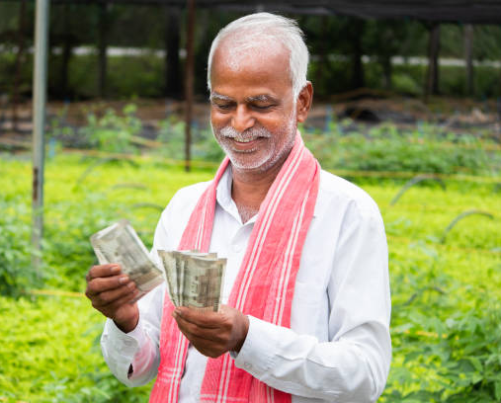
Introduction: Key Enhancements and Goals
Key Enhancements:
Improved Prediction Accuracy
Integration of Multiple Data Sources
User-Friendly Interface
Enhanced Security & Data Integrity
Scalability & Future Enhancements
Our goal is to make this system accessible to all users, including farmers, traders, policymakers, and students for future research.

Slide 8
PRODUCT VISION

Slide 9
Product Vision
“Empowering farmers, traders, and policymakers with AI-driven insights for smarter decision-making, optimized pricing, and sustainable agriculture. Our AI/ML-based Agroproducts Price Predictor aims to ensure data-driven market transparency, helping stakeholders maximize profits, reduce risks, and enhance food security for a resilient and better future.”
In simple words, the vision of this project is to help farmers, traders and policymakers to make better decisions based on the output from our Product, which will help them earn more and make better informed decisions related to Agriculture.

Slide 10
JUSTIFICATION OF SOCIAL DEVELOPMENT GOALS

Slide 11

Justification of Social Development Goals
Our project aims to align well with United Nations’ Sustainable Development Goals, the major ones we are predicting to align well with the project are:
SDG 1: No Poverty
SDG 2: Zero Hunger
Some additional SDGs that are directly or indirectly aligning with our product are:
SDG 8: Decent Work and Economic Growth
SDG 12: Responsible Consumption and Production
SDG 13: Climate Action

Slide 12
Justification of Social Development Goals SDG 1: No Poverty
Providing real-time price predictions, allowing farmers to sell their produce at optimal rates, maximizing earnings.
Offering historical price trend analysis, enabling traders and farmers to make informed purchasing and selling decisions.
Enhancing market access for small-scale producers, ensuring they receive fair compensation without exploitation by intermediaries.
Helping farmers adapt to economic shifts with AI-driven demand forecasting, reducing financial losses from unsold produce.

Slide 13
Justification of Social Development Goals SDG 2: Zero Hunger
Improving food distribution through demand-supply analysis, reducing food waste and ensuring availability in high-demand areas.
Enhancing agricultural planning by integrating weather data with price trends, helping farmers choose the best crops to cultivate.
Increasing productivity and profitability, making farming a more viable and sustainable livelihood.
Supporting government policies with data-driven market trend reports to ensure stable food supply chains.

Slide 14
Justification of Social Development Goals Additional SDGs
SDG 8: Decent Work and Economic Growth – Empowers farmers with market intelligence to secure fair wages and promotes digital innovation in agriculture.
SDG 12: Responsible Consumption and Production – Reduces food waste by aligning production with real-time demand insights.
SDG 13: Climate Action – Integrates weather-based predictions to help farmers adapt to climate variability and minimize losses.

Slide 15
DIAGRAMS

Slide 16
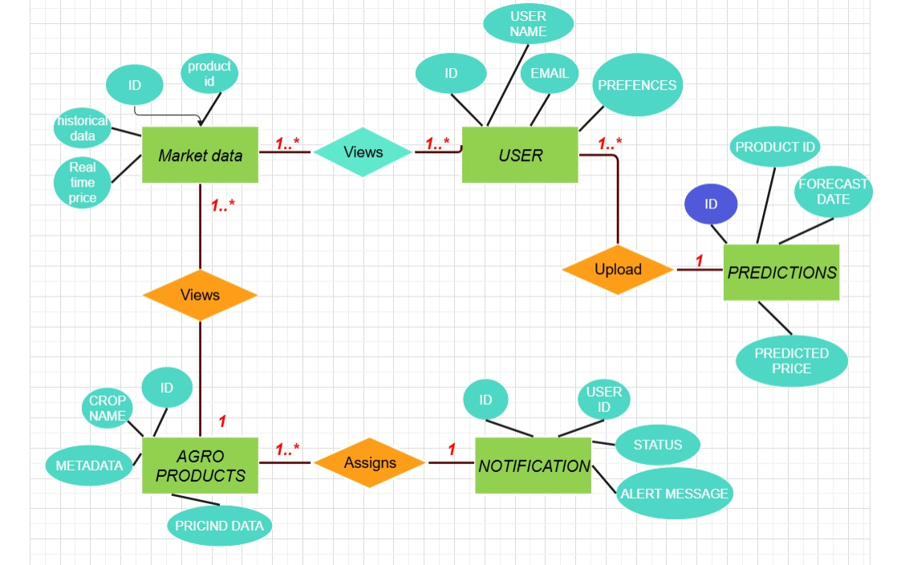
E-R Diagram for Review 1

Slide 17
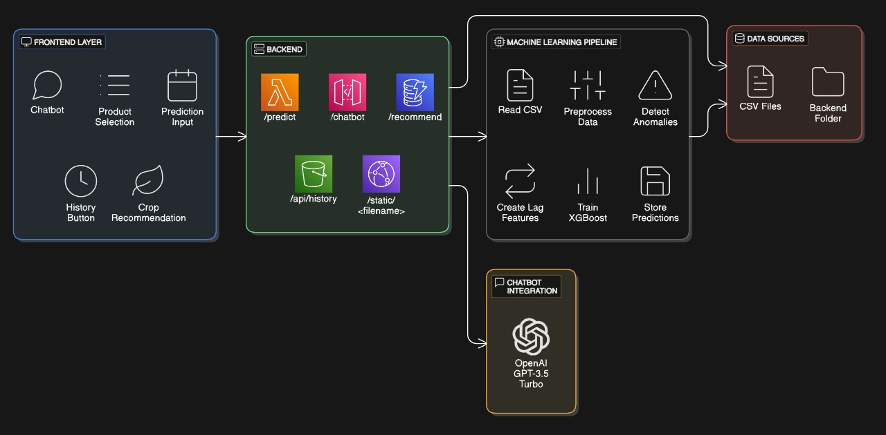
Architecture Diagram

Slide 18
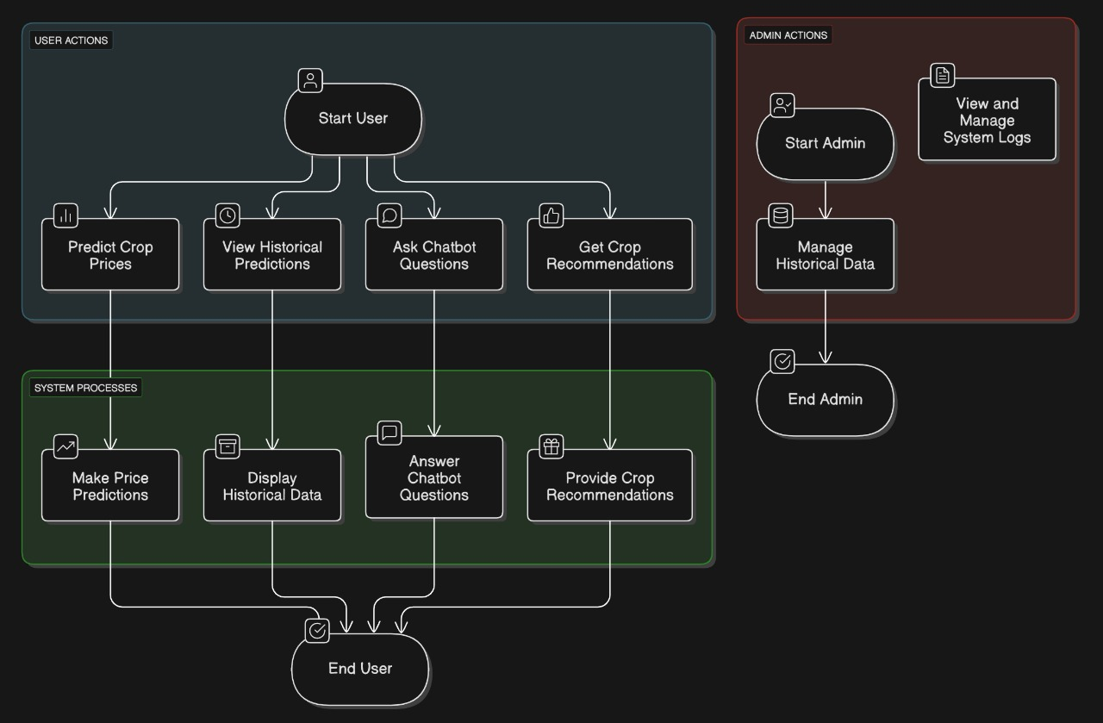
Use Case Diagram

Slide 19
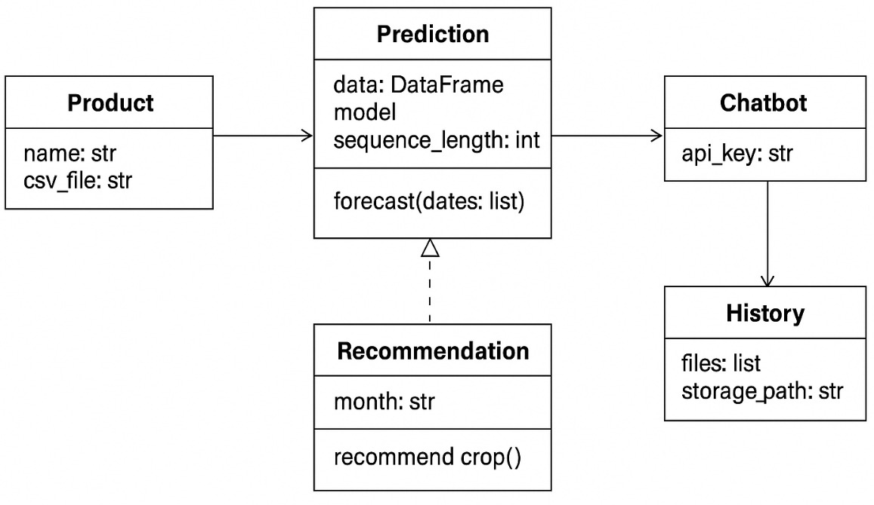
Class Diagram

Slide 20
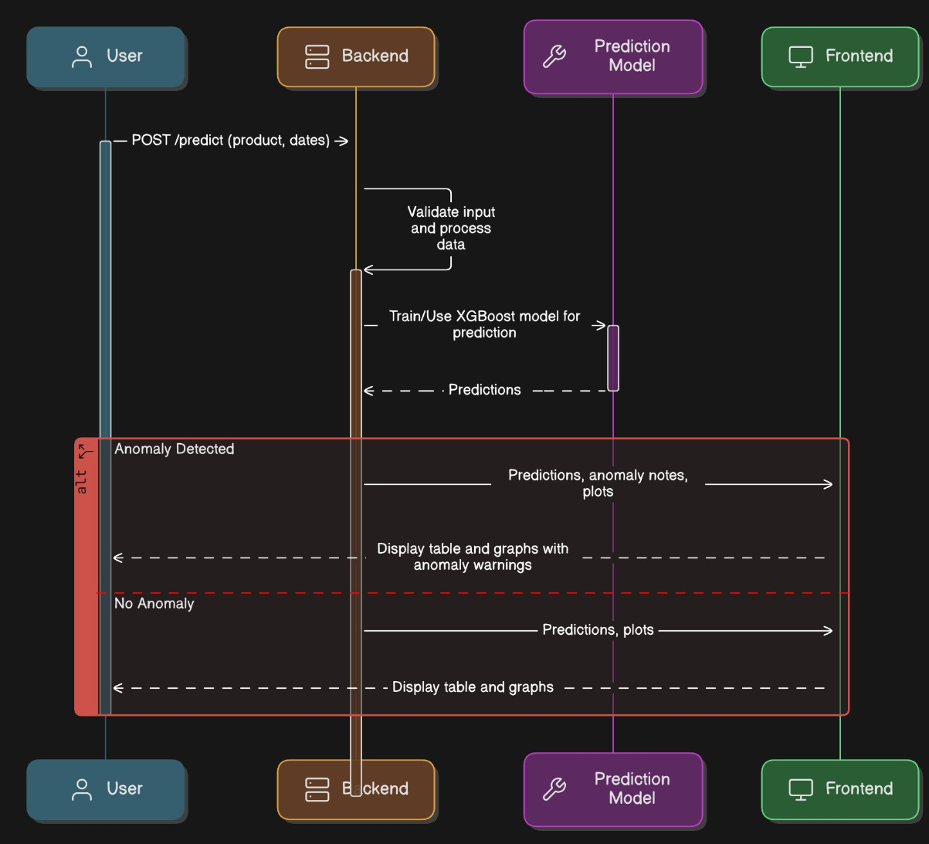
Sequence Diagram

Slide 21
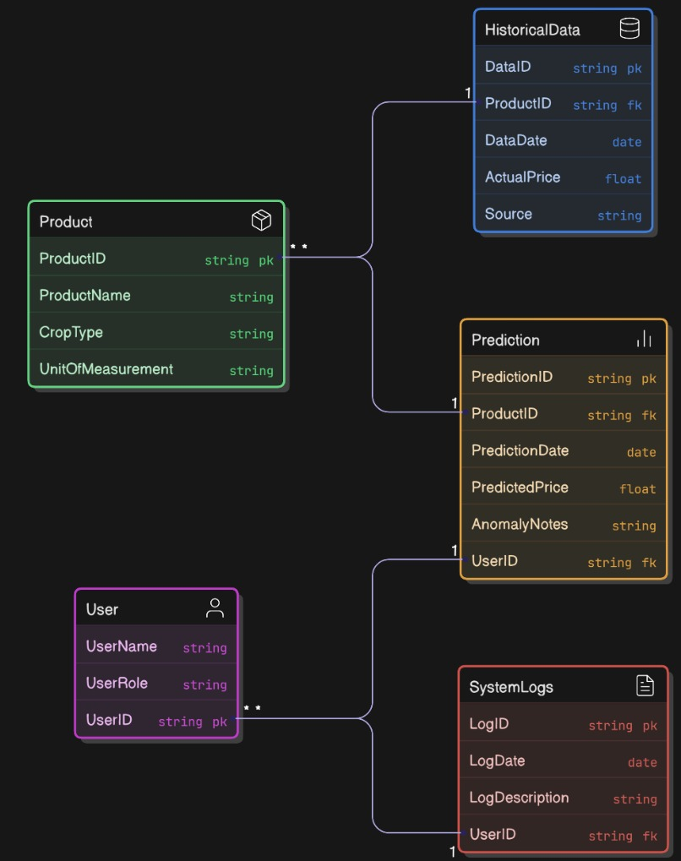
E-R Diagram for Review 2

Slide 22
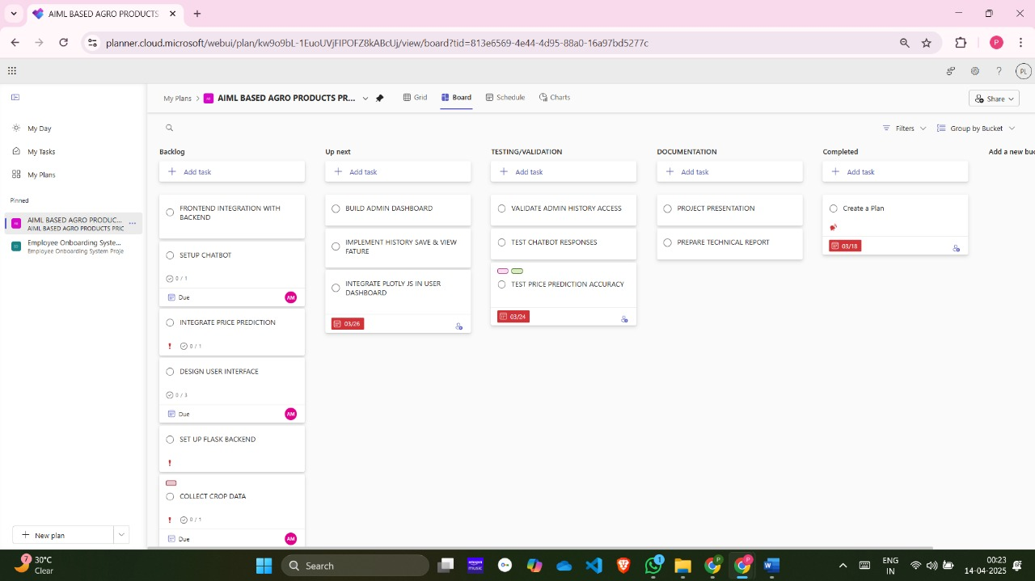
Microsoft Planner

Slide 23
EXISTING MODELS, CHALLENGES AND LIMITATIONS

Slide 24
Existing Models
As part of the Literature Survey, we came across some existing models in use for products similar to ours, some of them are:
Random Forest – A powerful ensemble learning method that improves accuracy by combining multiple decision trees.
Long Short-Term Memory (LSTM) – A type of neural network specialized for time-series forecasting, capturing long-term dependencies in price trends.
Gradient Boosting (XGBoost, LightGBM, CatBoost) – Boosting algorithms that enhance prediction accuracy by learning from past errors.
ARIMA (AutoRegressive Integrated Moving Average) – A statistical model commonly used for time-series forecasting based on historical trends.

Slide 25
Challenges and Limitations
Data Quality & Availability – Inconsistent or missing historical price and weather data affects model accuracy.
Feature Selection Complexity – Identifying the right factors influencing price trends is challenging.
Real-time Data Integration – Ensuring seamless updates from multiple sources like weather APIs and market trends.
Model Accuracy & Performance – Some models struggle with highly volatile markets and seasonal fluctuations.

Slide 26
Challenges and Limitations
Computational Efficiency – Advanced models like LSTMs and Transformers require high processing power.
Scalability Issues – Supporting multiple users while maintaining quick and accurate predictions.
Security & Data Integrity – Protecting sensitive agricultural data from tampering and cyber threats.
Limited Adoption & Awareness – Farmers and traders may need training to effectively use AI-based insights.

Slide 27
OUR SOLUTION

Slide 28
Solution
To overcome the challenges and limitations of existing models, we want our product to incorporate some improvements, including but not limited to:
Enhanced Data Quality – to fill data gaps.
Optimized Feature Selection – for accurate price predictions.
Improve Updates and Accuracy
Improving Model Performance – for better handling of volatile price fluctuations.
User-Friendly Interface –for easy accessibility
We want our solution to provide accurate, real-time, and secure price forecasts, enabling better decision-making and reducing risks in agriculture markets.

Slide 29
Solution
For Enhanced Data Quality, we are adding multiple data sets from the public domain to compare and predict prices for multiple crops. This can be scaled up to include 100s of data sets.
For Accurate Price Predictions, we have selected XGBoost, which is a gradient boosting model and algorithm that enhances prediction accuracy by learning from past errors.
For User-Friendly Interface, we have opted to keep the front end and back end as simple and straightforward as possible. We tried to do complex architecture but we instead opted to make a monolithic architecture we HTML, JavaScript, CSS for Front End and Python, Flask and related libraries like Pandas, NumPy and Matplotlib for the Back End.

Slide 30
Solution
The Database is locally hosted using CSV Files and Datasets, and the Graphs generated are also stored locally on the system.
For Data Visualization, we are using Plotly.js, Matplotlib and Pandas to create Reactive Graphs.
Using OpenAI GPT via API Integration, we have added a Chatbot for easier access to questions and answers if the graph is not sufficient.
We have also added a functionality to Recommend Crops based on the month entered by the user for maximum profit.
The entire system is hosted locally, so minimal network connections and internet is needed. The model and system can be used offline on PCs.

Slide 31
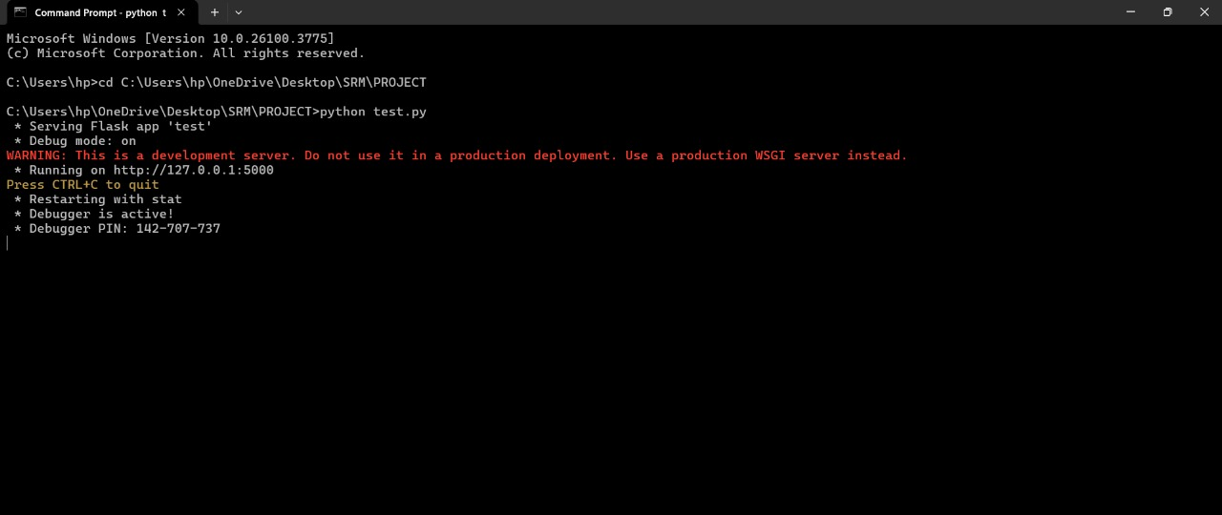
Screenshots Command Prompt to Start the Model

Slide 32
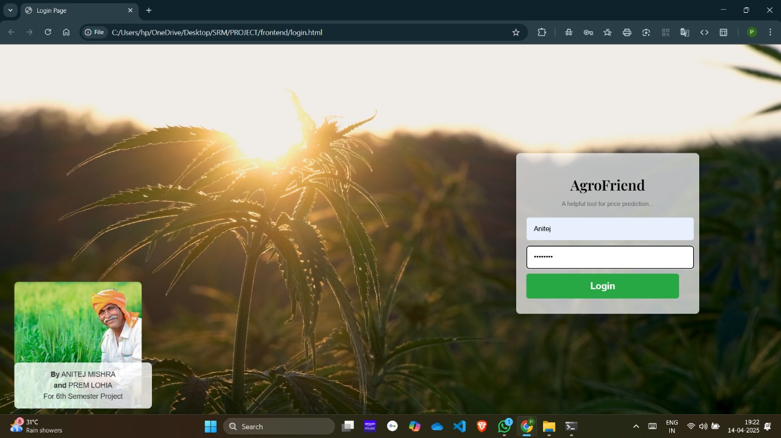
Screenshots Login Page

Slide 33
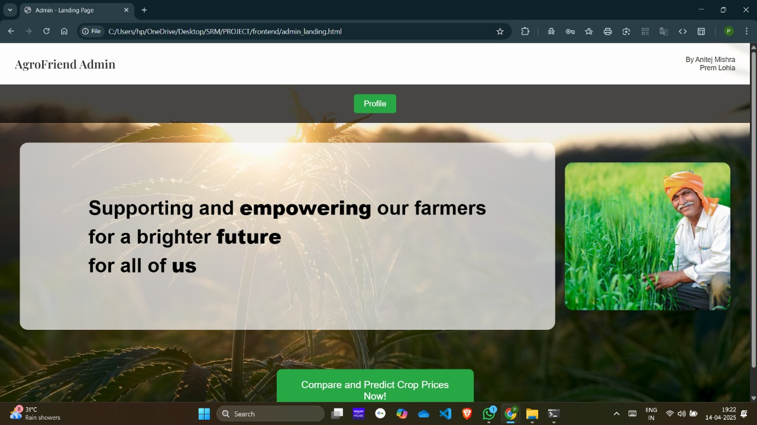
Screenshots Admin Home Page

Slide 34
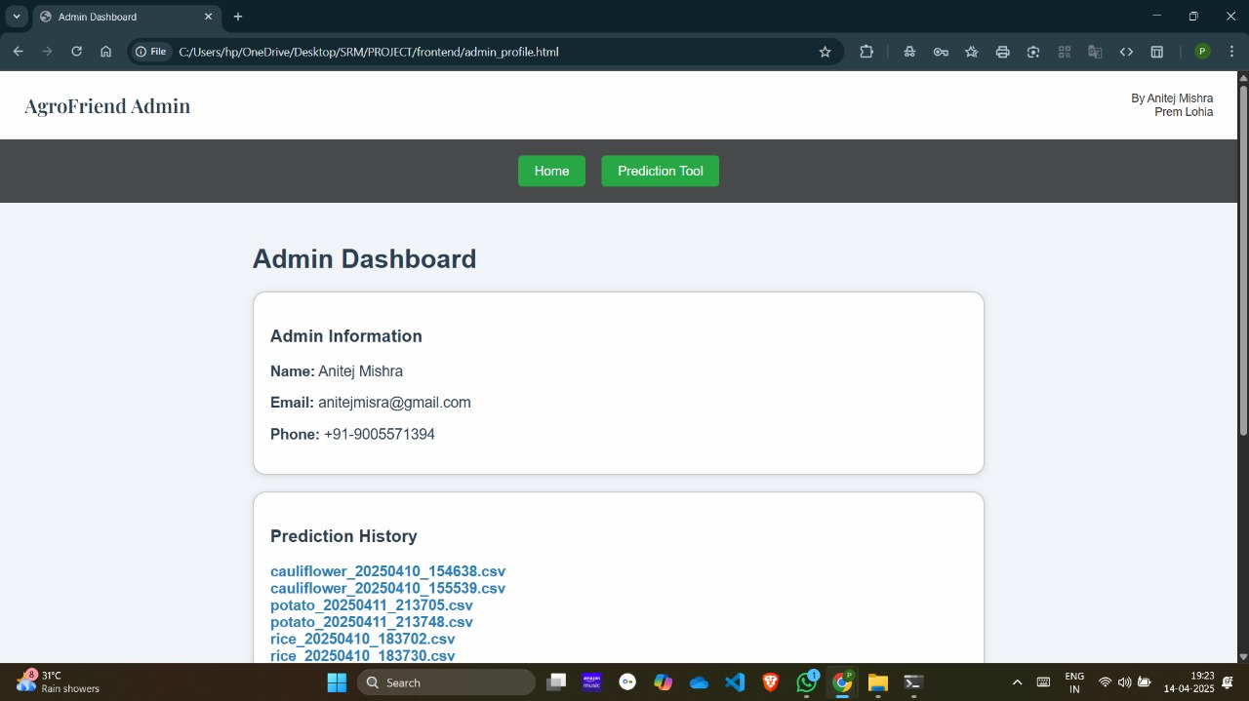
Screenshots Admin Profile Page

Slide 35
Screenshots User Home Page

Slide 36
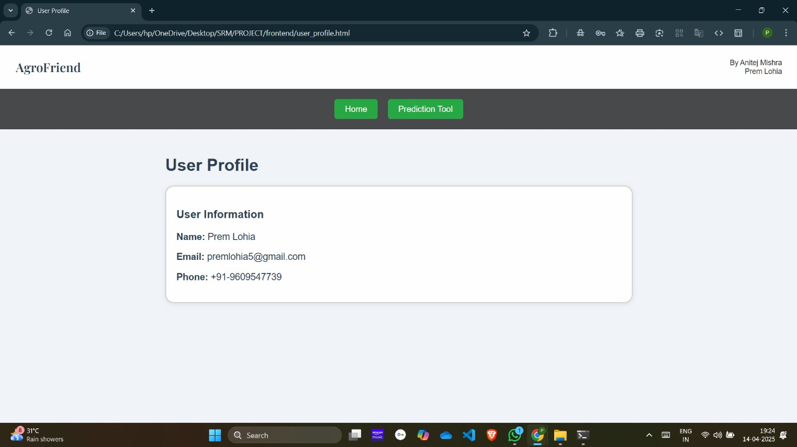
Screenshots User Profile Page

Slide 37
Screenshots User Prediction Tool Page with Chatbot

Slide 38
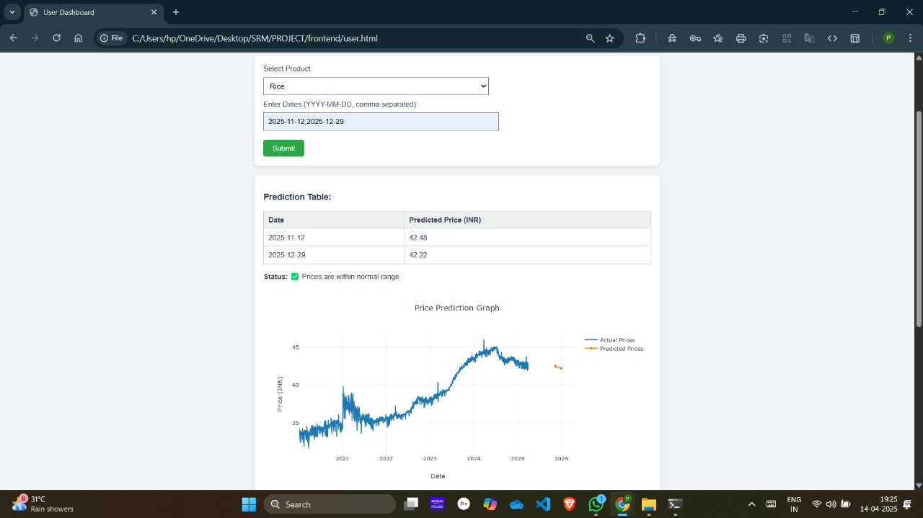
Screenshots Price Prediction with Reactive Graph

Slide 39
CONCLUSION

Slide 40
Conclusion
Our AI/ML-based Agroproducts Price Predictor aims to provide accurate, real-time price forecasts to help farmers, traders, and policymakers make informed decisions.
By addressing the challenges of existing models, we are integrating ML techniques, real-time data sources, and a user-friendly interface to improve prediction accuracy, scalability, and accessibility.
This project has the potential to enhance market transparency, reduce risks, and support sustainable agriculture, making it a valuable tool for stakeholders in the agricultural sector.

Slide 41
THANK YOU!
By Anitej Mishra [RA2211029010023]
& Prem Lohia [RA2211029010007]

